Slide 1
JCM OSCE
QMH A&E
7.11.2012

Slide 2
Case 1
M/29
Good past health
Recurrent skin rash over limbs x 6 months
Multiple medical consultations including dermatologists without improvement

Slide 4
1. What are the important points in the history?
Rash-related
Duration – onset, previous episodes, change
Distribution
Nature – pain, itch, discharge, systemic symptoms
Provoking & relieving factors
Response to treatment
Medical history – eczema
Family history – psoriasis
Allergies
Occupation – exposure to chemicals
Social – smoking, alcohol, drug use

Slide 5
Name 2 differentials
“Meth mites” / delusional parasitosis due to methamphetamine abuse
Scabies
Dermatitis herpetiformis
Discoid lupus
Notes:
Heavy stimulant use causes a rise in body temperature and increased blood flow to the skin to counteract it.
The produced sweat contains an enzyme that increases blood flow to the skin even more.
When the sweat evaporates, it removes the protective sebaceous oil which coats the skin.
The combined effects of dehydration, sweating and removal of the sebaceous oil on the skin create a sensation on the nerve endings on the skin and cause the addict feelings of something irritating or "crawling" on or under (parasitosis) the skin. Also to be mentioned here is that the skin is an escape route for the toxic wastes used to create the drug.
The psycholocical aspects of this drug complicate the situation even more by causing the user to tweak out and obsessively pick, scrape and dig at their skin.
This action, is generally performed with the fingernails (staph havens) but can also be performed with any number of chosen "tools" which could be any object found in an ordinary home that could be used for picking or scraping.
The results are penetration and removal of the dermis, causing open, red (often bleeding) sores, most commonly on the face and arms but can be anywhere on the body. This provides a potential breeding ground for staph infection.

Slide 6
What is the plan of management?
Antibiotics if signs of infection
Referral to substance abuse clinics, counseling and rehabilitation programs

Slide 7
Case 2
M/37
PMH: Schizophrenia
Brought in by mother for decrease GC in recent few days
Poor appetite with vomiting

Slide 8
BP 137/76, P 102
T 36.9 °C
SpO2 100% (2L O₂)
H’stix Hi
ABG:
pH 6.9
Na 152
K 2.2
Cl 124
HCO₃ 16
BE -28

Slide 9
What is the diagnosis?
Diabetic ketoacidosis (DKA)

Slide 10
If Glucose is 52, what is the corrected Na? Why is that important?
Corrected Na = Na + [(Glucose-10)/3] in mmol/L
Corrected Na = 152 + [(52-10)/3] = 166
The corrected Na can be used to estimate the severity of dehydration in severe hyperglycemia
However, the actual measured sodium concentration should be used when calculating the anion gap

Slide 11
He was recently started on Olanzapine for schizophrenia, what is the significance?
There is evidence showing that atypical antipsychotics olanzapine and clozapine are associated with increased risks of diabetes
The exact mechanism is not fully understood, but the associated weight gain may contribute to it
Some patients may present with DKA
Notes:
The mechanisms responsible for the elevated risk of diabetes associated with some antipsychotics are not fully understood. It is known that the atypical antipsychotics and some of the low potency conventional antipsychotics cause weight gain and that, at least for olanzapine and clozapine, the magnitude of this weight gain correlates with the magnitude of the therapeutic response. The weight gain in response to antipsychotic medication is also variable. Clozapine and olanzapine cause the greatest gain, risperidone and quetiapine moderate gain, and aripiprazole and amisulpride the least gain.8 However, at present insufficient information is available about some of the newer drugs to know what their weight gain and diabetogenic potential will prove to be with more widespread use.
Obesity can precipitate diabetes in susceptible people so weight gain is one mechanism for the increased incidence in diabetes. However, the fact that hyperglycaemia improves quickly after stopping the antipsychotic medication and that diabetes can appear in some patients who do not put on weight, suggests that other mechanisms must be involved. A prospective study of 82 patients treated with clozapine also found that the risk of developing diabetes was independent of weight gain.

Slide 12
Case 3
M/55
Good past health
SOB x 2 months
Dry cough

Slide 14
What are the 2 clinical signs?
Telangiectasia
Distended neck veins
Name 3 differential diagnoses
CA lung
Lymphoma
Leukemia
TB

Slide 15
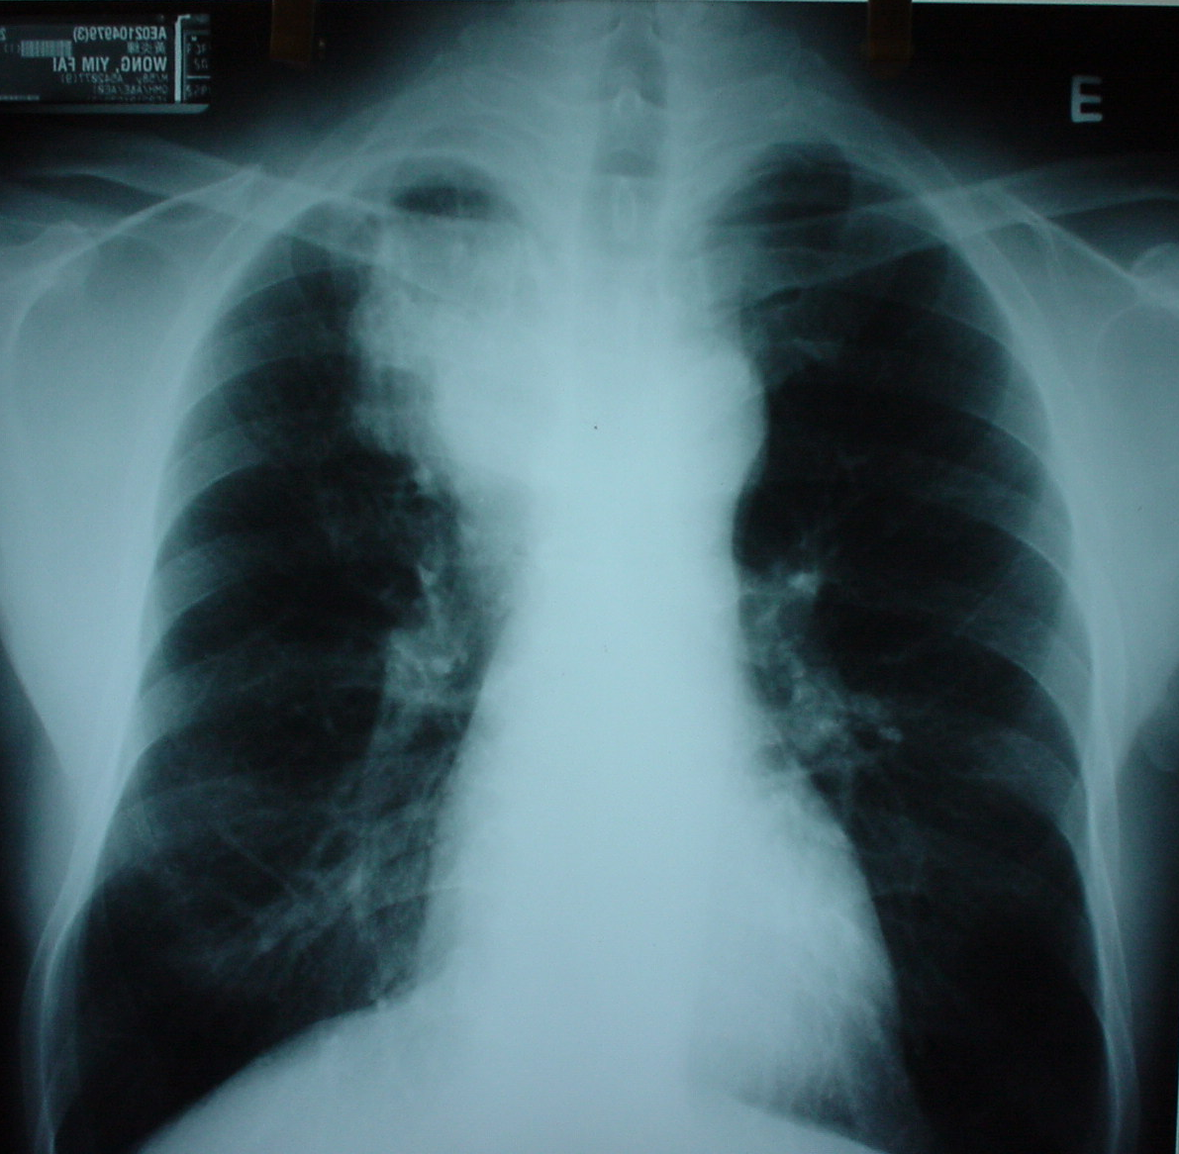

Slide 16
What are the CXR findings?
RUZ mediastinal mass
What is the diagnosis?
Superior vena cava obstruction (SVCO) due to underlying CA lung

Slide 17
Case 4
F/4
Good past health
Vaccinations up to date
Irritable and refused oral feeding for 2 days

Slide 18
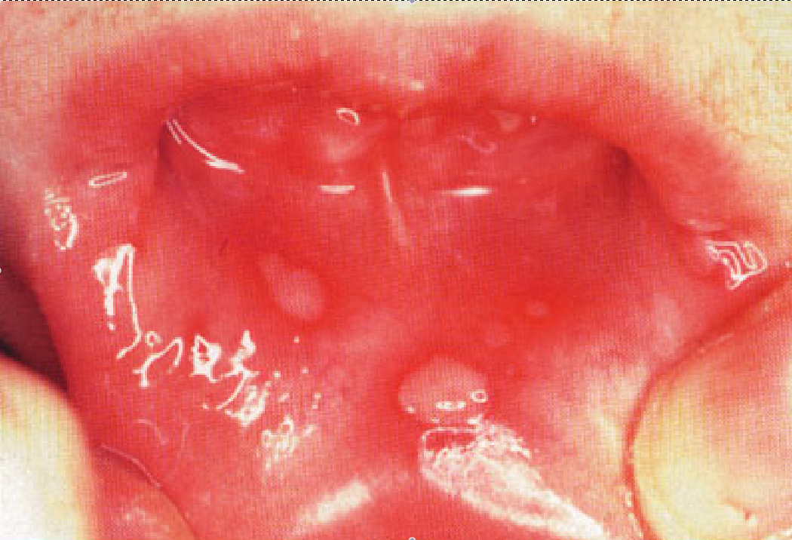

Slide 19
What is the most common causative agent?
Herpes simplex virus type 1
Usually presents as gingivostomatitis in children
What is the incubation period?
1 – 26 days
Median: 6-8 days

Slide 20
Name 3 locations where lesions can occur
Pharynx
Gum
Buccal mucosa
Soft palate
Tongue
Floor of the mouth
Lips

Slide 21
Name 3 systemic symptoms
Fever
Malaise
Myalgia
Irritability
Cervical lymphadenopathy

Slide 22
What is the appropriate treatment?
Symptomatic relief and hydration
Antivirals are controversial
1 study has shown that Acyclovir 15mg/kg 5x/day for 1 week is effective in shortening the duration of symptoms if started within the first 3 days of onset
Treatment of herpes simplex gingivostomatitis with aciclovir in children:
a randomised double blind placebo controlled study. BMJ 1997; 314:1800

Slide 23
Case 5
M/24
PMH: Chronic solvent abuse
Dizziness for 2 days
Nausea but no vomiting
Mild SOB, no cough or fever
Denied recent drug use

Slide 24
BP 102/59, P 110
T 37.2 °C
SpO2 98% (2L O₂)
RR 24
Urine pH 7.2

Slide 25
ABG / RFT:
pH 6.94
FiO₂ 0.4
pO₂ 18
pCO₂ 2.3
BE -28
HCO₃ 10
Na 125
K 2.9
Cl 113

Slide 26
Interpret the ABG results
Metabolic acidosis with respiratory compensation
Anion gap = (Na + K) – (Cl + HCO₃)
= (125 + 2.9) – (113 + 10)
= 4.9
Normal anion gap metabolic acidosis

Slide 27
What are the common causes?
Normal anion gap acidosis = USED CARP
Ureteroenterostomy
Small bowel fistula
Extra chloride
Diarrhoea
Carbonic anhydrase inhibitors
Adrenal insufficiency
Renal tubular acidosis
Pancreatic fistula

Slide 28
What is the possible agent of abuse?
Toulene
What is the cause of the current presentation?
Chronic toulene toxicity induced renal tubular acidosis type I

Slide 29
Thank You!

